Slide 1


School of Technology, Design and Computer Application Silver Oak College of Compter Application
Department of Computer Application
Silver Oak College of Computer Application
Department of Computer Application
A PROJECT PRESENTATION
ON
To do list
Submitted By:
Shah Bhavya (2404070100047)
Kukreja Manisha (2404070100048)
Prajapati Aarchi (2404070100050)
Master of Computer Application
Semester III
Group No:
Guide
Mr. Shubh Shah
Submitted To
Department of Computer Application
Silver Oak University, Gota, Ahmedabad, 382481
Academic Year 2025-26
A PROJECT PRESENTATION ON
Modern to-do
Submitted By
Patel Mitu (2404070100147)
Salunke Ayushi (2404070100190)
Master of Computer Application
Semester III
Group No: 17
Guide
Ms. Jeenal Panchasara
Submitted To
Department of Computer Application
Silver Oak University, Gota, Ahmedabad, 38248
Academic Year 2025-26

Slide 2
1.INTRODUCTION
The "E-commerce Website" project aims to create a dynamic, user-friendly online platform for buying and selling products. This system will serve as a digital storefront, allowing businesses to showcase their products to a global audience and customers to browse, select, and purchase items conveniently. The platform will be scalable, secure, and intuitive, catering to the growing demands of the online retail market.

Slide 3
2.ABSTRACT
This document outlines the development of a comprehensive e-commerce website. The project will address the challenges faced by traditional retail by providing an efficient, accessible, and secure online shopping experience. Key functionalities will include product browsing, a secure shopping cart, multiple payment options, order tracking, and a robust user management system. The system will be built using modern web technologies to ensure a responsive design and high performance.

Slide 4
3.OBJECTIVE
○ To develop a fully functional e-commerce website that supports the entire online shopping process, from product selection to payment and delivery.
○ To provide a secure and reliable platform for online transactions.
○ To create an intuitive and easy-to-navigate user interface for a seamless shopping experience.
○ To implement a robust backend system for inventory management, order processing, and customer data management.
○ To ensure the website is responsive and accessible on various devices, including desktops, tablets, and smartphones.

Slide 5
4.Problem Definition
The primary problem is the inefficiency and limited reach of traditional brick-and-mortar retail. Businesses are often confined to a specific geographical location, limiting their potential customer base. Similarly, consumers are restricted by store operating hours and physical availability of products. The proposed e-commerce website will solve these issues by providing a 24/7 global marketplace, enabling businesses to expand their reach and offering customers unparalleled convenience and access to a wider variety of products.

Slide 6
5. Existing System
Currently, many small and medium-sized businesses either rely on traditional retail methods or use generic social media platforms for sales. These existing systems often lack essential e-commerce features such as integrated payment gateways, automated inventory management, and secure user data handling. This leads to manual and error-prone processes, a poor customer experience, and security vulnerabilities.

Slide 7
Methodology
The project follows the Agile development methodology with iterative development and testing.
Steps:
Requirement Gathering – Identify functional and non-functional requirements.
System Design – Define database schema, frontend components, and backend APIs.
Frontend Development – HTML, CSS and JavaScript are used.
Backend Development – PHP (Laravel) for the backend.
Database Integration (MySQL or PostgreSQL) – Store user details, groups, and chat history.
Testing & Deployment – Perform unit, integration, and user acceptance testing before deployment.

Slide 8
4.1 Requirement Analysis
This phase involves identifying and documenting all the necessary functionalities and constraints for the e-commerce system.
4.1.1 Software Requirements
Operating System: Windows, macOS, or Linux.
Web Server: Apache or Nginx.
Database: MySQL or PostgreSQL.
Programming Languages: HTML, CSS, JavaScript for the frontend; Python (Django/Flask) or PHP (Laravel) for the backend.
E-commerce Framework: Custom-built or open-source platforms like Magento, WooCommerce, or Shopify.
Security: SSL/TLS certificate for secure data transmission.
Payment Gateway: Integration with services like Stripe, PayPal, or a local payment provider.

Slide 9
4.1.2 Hardware Requirements
Server: A dedicated server or cloud hosting service (e.g., AWS, Google Cloud) with a minimum of 8 GB RAM and a multi-core processor to handle user traffic.
Storage: 500 GB SSD for fast data access and a large volume of product images and data.
Network: High-speed internet connection for consistent server uptime.

Slide 10
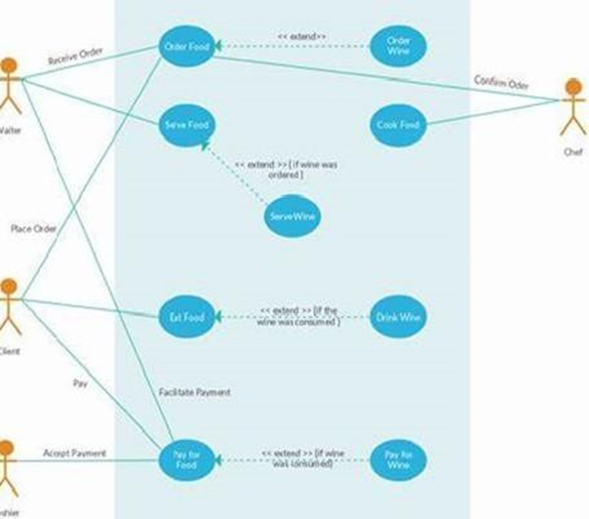
System Design
Use Case :

Slide 11
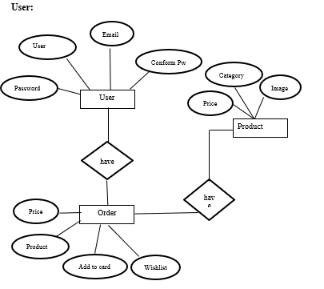
E-R Diagram

Slide 12
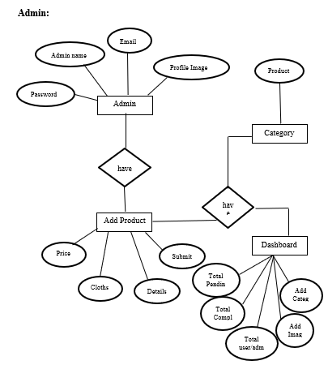

Slide 13

Data Flow Diagram

Slide 14
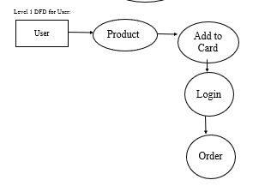

Slide 15
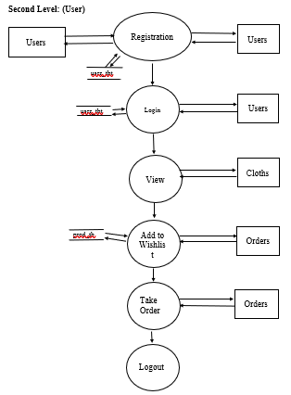
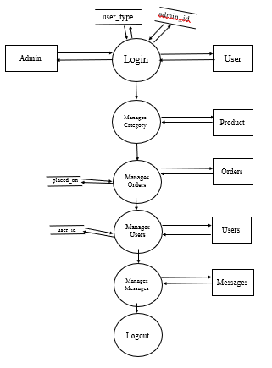
Level 2 Admin DFD:

Slide 16
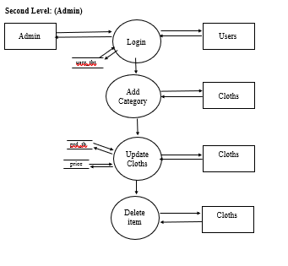

Slide 17
DATA DICTIONARY
User:
Field | Data Type | Key | Description
user_id | INT AUTO_INCREMENT | PK | Primary key — unique user identifier
Name | VARCHAR(150) |  | Full name of the user
Email | VARCHAR(255) | UQ | User email (used to login)
password_hash | VARCHAR(255) |  | Hashed password
Role | ENUM(‘user’,‘admin’) |  | Role for access control
Phone | VARCHAR(20) |  | Optional contact number
created_at | DATETIME |  | Account creation timestamp
Categories:
Field | Data Type | Key | Description
user_id | INT AUTO_INCREMENT | PK | Primary key — unique user identifier
Name | VARCHAR(150) |  | Full name of the user
Email | VARCHAR(255) | UQ | User email (used to login)
password_hash | VARCHAR(255) |  | Hashed password
Role | ENUM(‘user’,‘admin’) |  | Role for access control
Phone | VARCHAR(20) |  | Optional contact number
created_at | DATETIME |  | Account creation timestamp

Slide 18
Products:
Cart:
Field | Data Type | Key | Description
product_id | INT AUTO_INCREMENT | PK | Unique product id
category_id | INT | FK -> categories(category_id) | Product category
Name | VARCHAR(200) |  | Product title
Slug | VARCHAR(220) | UQ | URL-friendly product name
Description | TEXT |  | Product detailed description
Price | DECIMAL(10,2) |  | Unit price
Stock | INT |  | Number of units available
Image | VARCHAR(255) |  | Main image path/filename
created_at | DATETIME |  | Timestamp added
Field | Data Type | Key | Description
cart_id | INT AUTO_INCREMENT | PK | Unique cart row id
user_id | INT | FK -> users(user_id) | Owner of the cart row
product_id | INT | FK -> products(product_id) | Product added to cart
product_name | VARCHAR(200) |  | Snapshot of product name
price | DECIMAL(10,2) |  | Snapshot of product price
quantity | INT |  | Quantity selected
added_at | DATETIME |  | When the item was added

Slide 19
Order :
Messages:
Field | Data Type | Key | Description
order_id | INT AUTO_INCREMENT | PK | Unique order id
user_id | INT | FK -> users(user_id) | User who placed the order
total_amount | DECIMAL(12,2) |  | Sum of order items
Status | VARCHAR(50) |  | e.g. pending, paid, shipped, delivered, cancelled
shipping_address | TEXT |  | Shipping information snapshot
payment_method | VARCHAR(50) |  | e.g. card, netbanking, COD
created_at | DATETIME |  | Order placement time
Field | Data Type | Key | Description
message_id | INT AUTO_INCREMENT | PK | Unique message id
user_id | INT NULL | FK -> users(user_id) | If logged in, reference to user
name | VARCHAR(150) |  | Sender name (for guest messages)
email | VARCHAR(255) |  | Sender email
subject | VARCHAR(255) |  | Message subject
message | TEXT |  | Message body
is_read | TINYINT(1) |  | 0 = unread, 1 = read
created_at | DATETIME |  | Submission time

Slide 20
Reviews:
Admin:
Field | Data Type | Key | Description
review_id | INT AUTO_INCREMENT | PK | Unique review id
product_id | INT | FK -> products(product_id) | Reviewed product
user_id | INT | FK -> users(user_id) | Reviewer
rating | TINYINT |  | Rating (1-5)
comment | TEXT |  | Review comment
created_at | DATETIME |  | When review was posted
Field | Data Type | Key | Description
admin_id | INT AUTO_INCREMENT | PK | Unique admin id
user_id | INT | FK -> users(user_id) | Associated user account
privileges | TEXT |  | Comma-separated special permissions

Slide 21
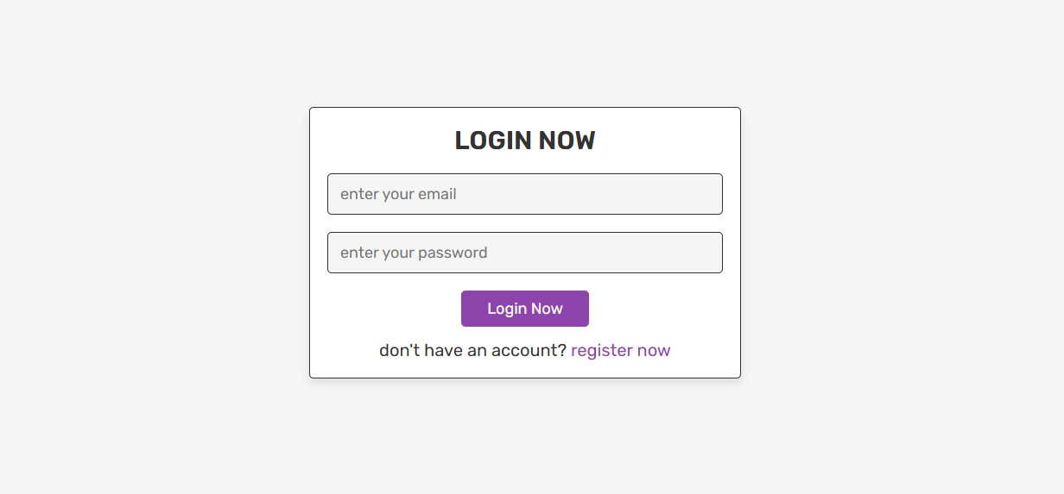
Screen Shorts

Slide 22
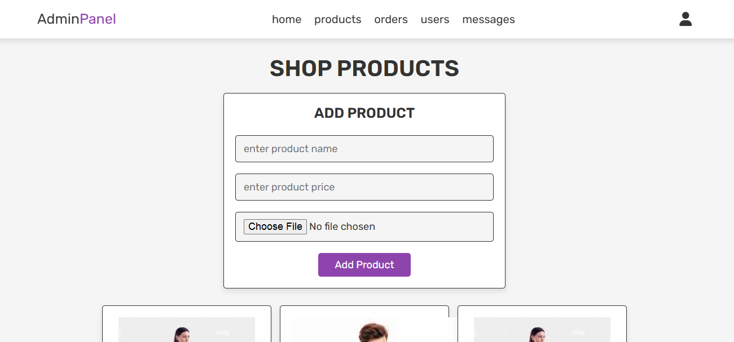
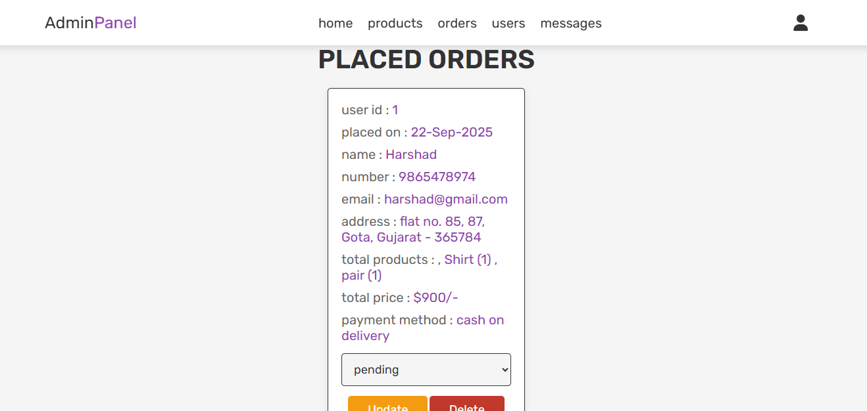

Slide 23
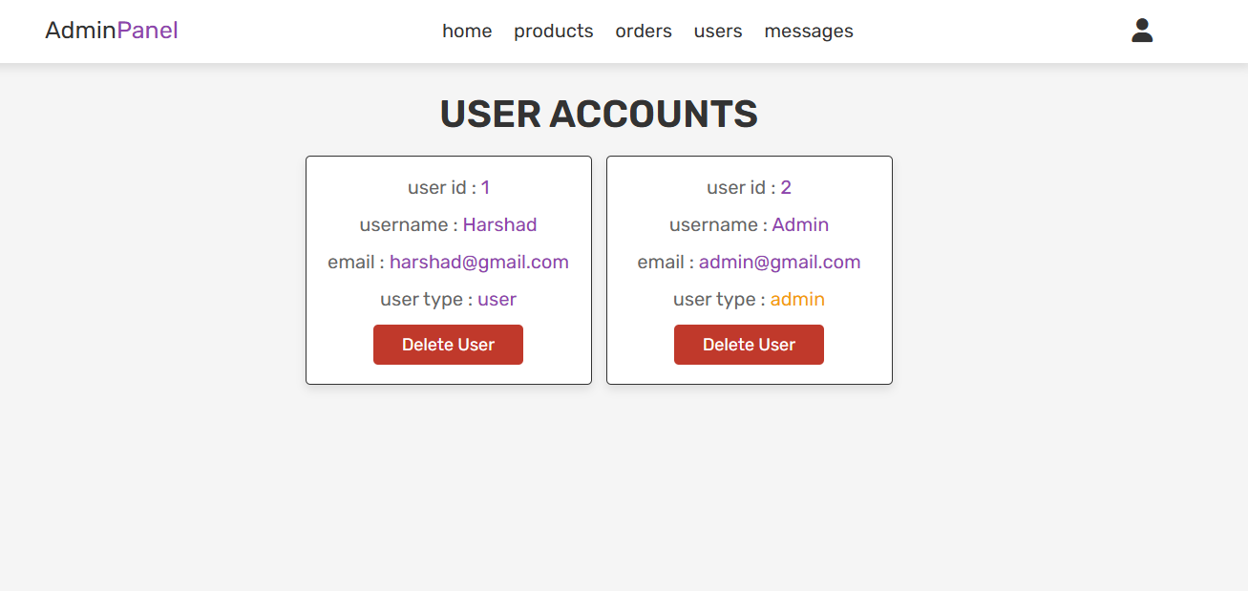
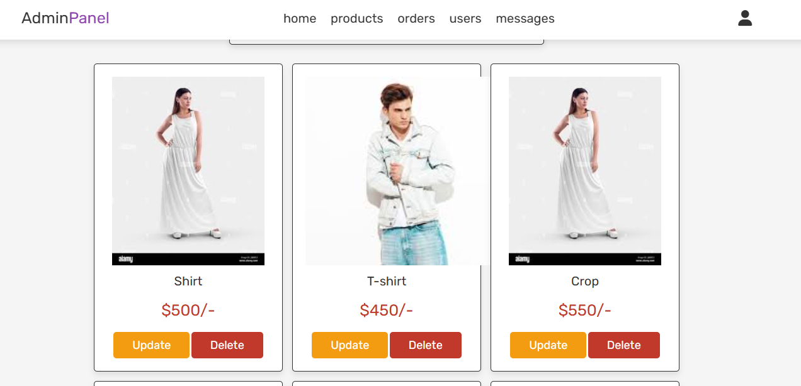

Slide 24
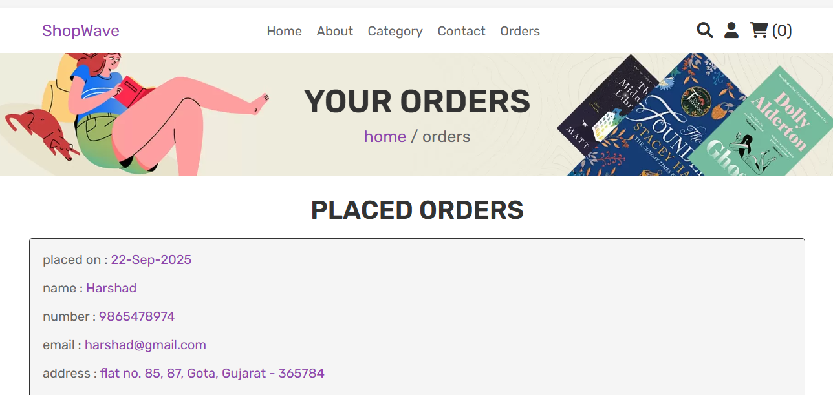
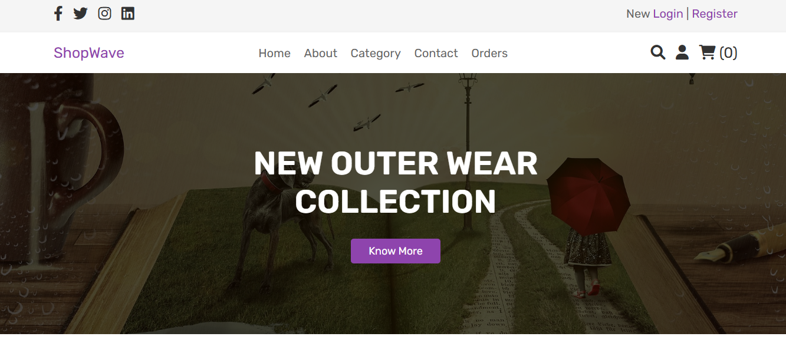

Slide 26
Thank You

